Slide 1
Real Time Rendering of Skeletal Implicit Surfaces
MS.c. Thesis

Slide 2
Outline
Motivations - Objectives
Implicit surfaces
Definitions and examples
Our surface representation
The Polygonal modeling pipeline VS. The implicit modeling pipeline
Rendering implicit surfaces
Ray-tracing Skeletal implicit surfaces with bisection
Implementation details
Evaluation of the method
Solutions for texturing skeletal implicit surfaces
Evaluation of the method
Conclusion and future work

Slide 3
Motivations
Implicit surfaces are
Smooth
Compact
Convenient for modeling
Suitable to be ray-traced
The graphics pipeline uses polygons but polygons are not really friends with implicit surfaces.
Recent works showed the possibility to ray trace implicit surfaces in real time on the GPU.
Why not modeling with implicit surfaces and ray-trace them on the GPU?

Slide 4
Objectives
Review modelling techniques with implicit surfaces.
Design and Implement a ray-tracer on the GPU that can render a chosen model.
Make it as fast as possible – comparable to polygon rendering.
Allow the same possibilities than the polygon pipeline.
Animation, texturing effects, ...

Slide 5
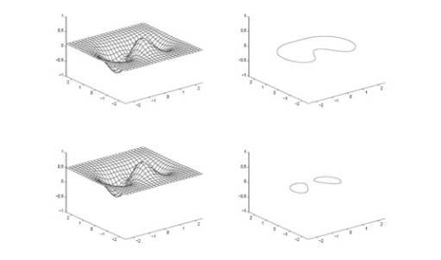
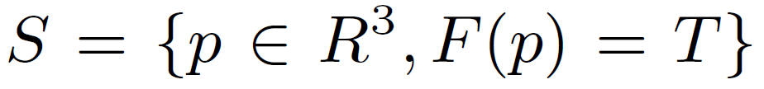
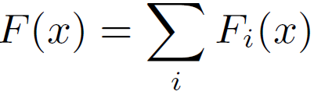



Implicit surfaces
Iso-Level set surface
Soft Objects
Metaballs
Convolution surfaces

Slide 6
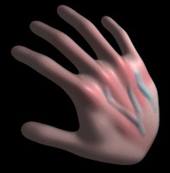
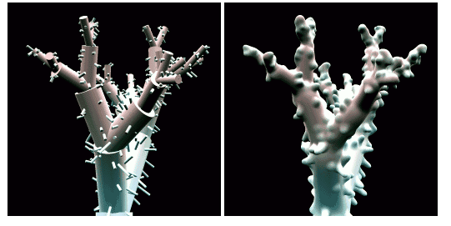
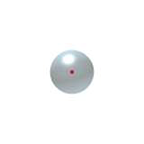

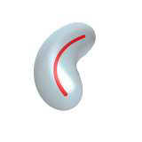

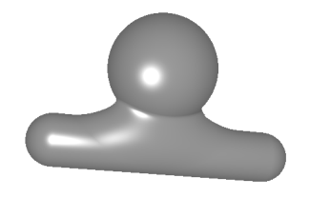
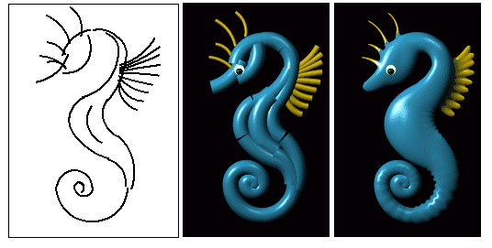
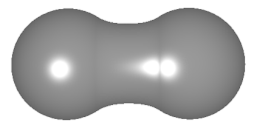
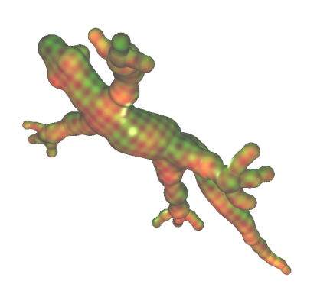
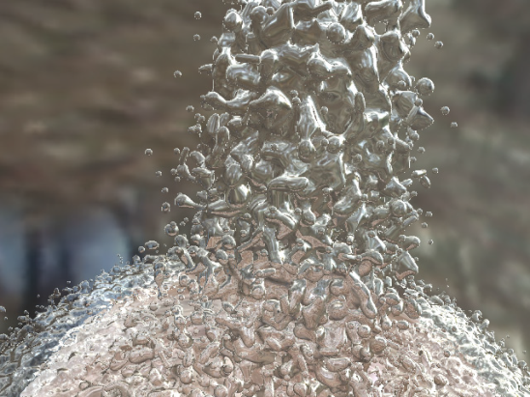
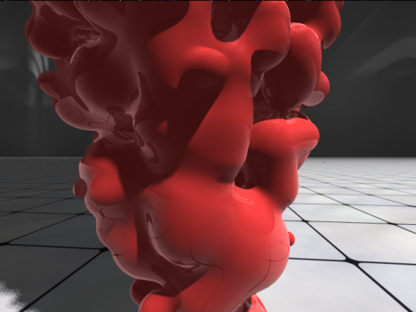
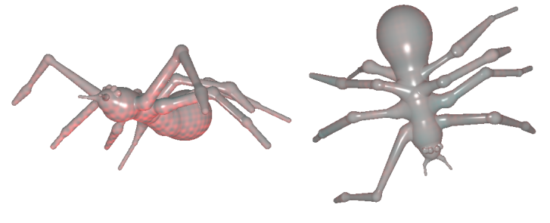
Implicit surfaces
Skeletal Implicit Surfaces
Convolution surfaces
Many metaballs
Skeletal Implicit surfaces in my project

Slide 7
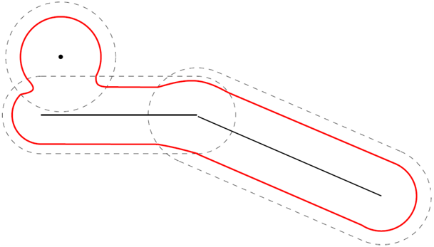
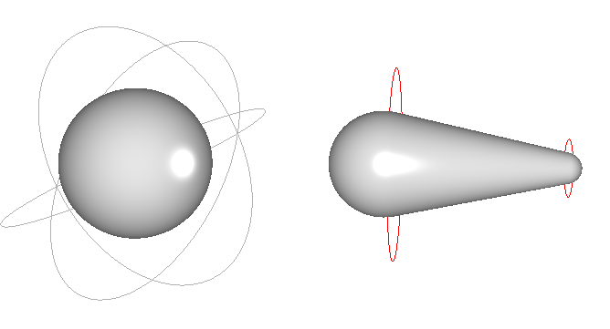
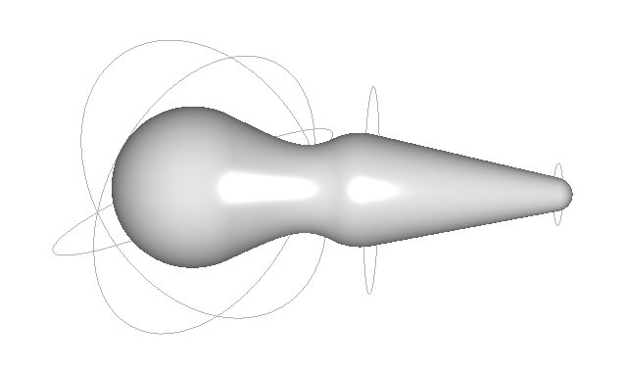
Chosen surface representation
Sleletal implicit surfaces with point and segment primitives.
Degree 4 polynomials

Slide 8
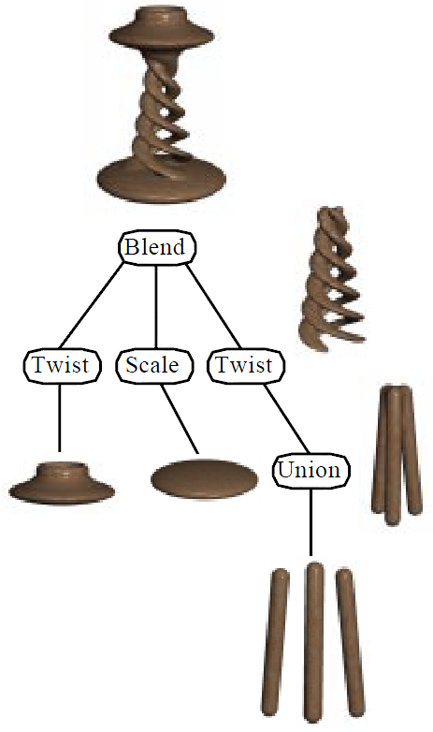
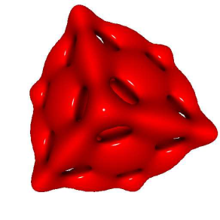
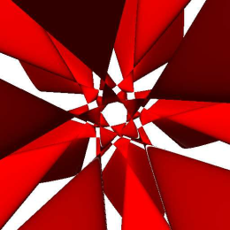
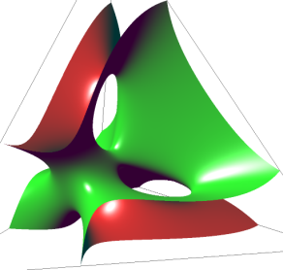
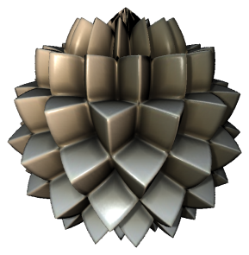
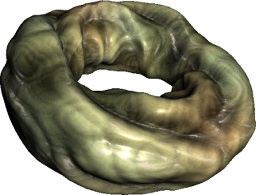
More Implicit Surfaces

Slide 9
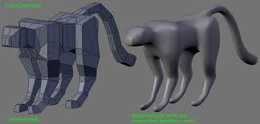
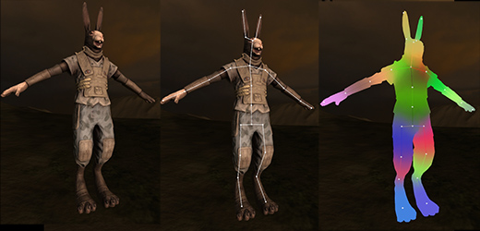
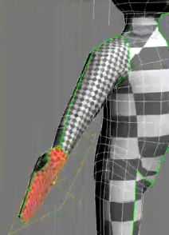
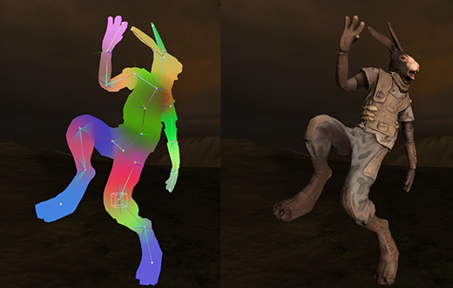
Polygonal modeling

Slide 10
The polygonal modelling pipeline
Per polygon modelling (extrusion, edge cut, push and pull vertices, ...)
Surface subdivision
Surface Unwraping – local paramtrization of the mesh, texture painting in texture atlas
Rigging
Vertex painting
Pose editing

Slide 11
Implicit modelling pipeline
Sketal modeling
High level surface editing
(Rigging)
Unwraping
animation

Slide 12
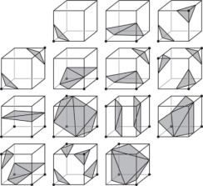
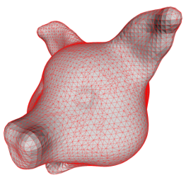
Rendering Implicit surfaces
Polyginizing
Marching Cubes
Ray Tracing
Ray marching
Interval Arithmetic
Sphere Tracing
Bezier Clipping

Slide 13
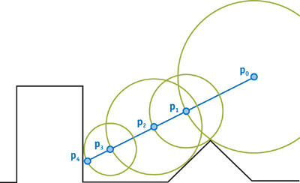
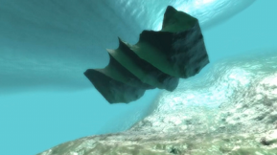
Sphere Tracing
At each iteration, find the distance to the closest point on the surface.
Very efficient if the objects are defined implicitly by a Signed Distance Function (SDF)
Problem : Computing the SDF of our surface

Slide 14
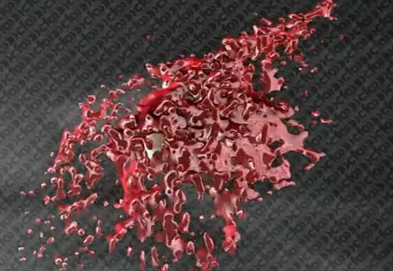
SDF for metaballs
Render the SDF into a volume
render the centre values for each sphere into the volume, scaled by the metaball weight, and with the metaball weight (the usual (1-d^2)^3) in the alpha channel. so its like float4(position.xyz * weight,weight); and additive blend all of those. then a post pass to divide the weighted position sum by the weight sum. then store the signed distance to that weighted average position. that works as your distance field.

Slide 15
Bézier Clipping

Slide 16
Implementation details – Data structures
Implicit surface :
Plain array of vectors and floats to map directly to the GPU memory
Bone data structure :
Tree of nodes {Quaternion, lenght}
Indices to the primitives attached

Slide 17
Implementation details – On the CPU
Animation player Updates the hone orientations.
Bones update primitive positions
Update the AABB of all the primitives
Primitives sents to the GPU as uniform variable (prefferably texture memory)
Render the AABB of the primitives
...

Slide 18
Implementation details – Ray tracing on the GPU
Vertex shader is passthrough. World position of the vertices interpolated to the fragment shader.
In the Vertex shader:
Construct ray from eye to fragment.
Discard non contributing primitives
Find a point inside the surface
Find intersection by bisection

Slide 19
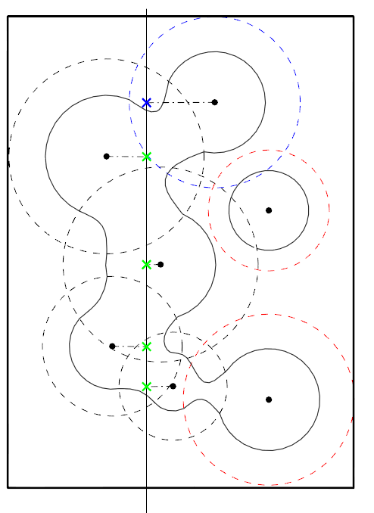
Implementation
For each primitive
Find a candidate point inside the surface
If the point is outside the surface of influence
Discard it
If the function is positive
Save it as well as the point
Otherwise
Discard it

Slide 20
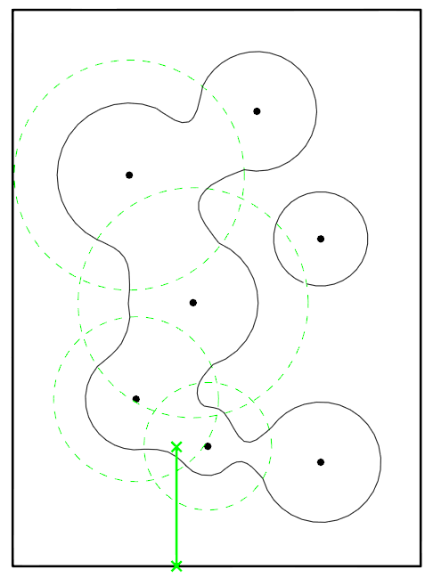
Implementation
Select the closest candidate point to the viewer
Find the ray-surface intersection by bissection using only the remaining primitives

Slide 21
Analysis
Finding the intersection is fast, less than 10 subdivision steps
First discarding pass is O(n2)
There might be many primitives on the ray that dont contribute
Poor scalability

Slide 22
Timing
Model | Nb Points | Nb Segments | Min FPF () | Max FPS (~100 pix)
Sphere | 1 | 0
Tube | 0 | 1
Gecko | 66 | 0
TRex |  |  | 2,45 | 230
Spider |  |  | 4,3 | 225
Tree

Slide 23
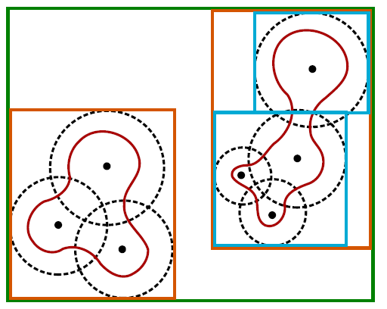
Toward Better scalability
Need a spatial data structure.
BVH, Kd-Tree
Fitted BVH

Slide 24
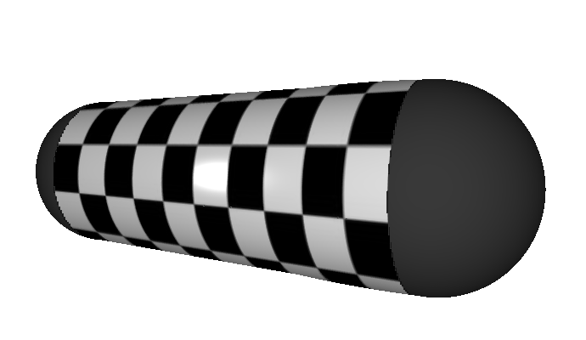
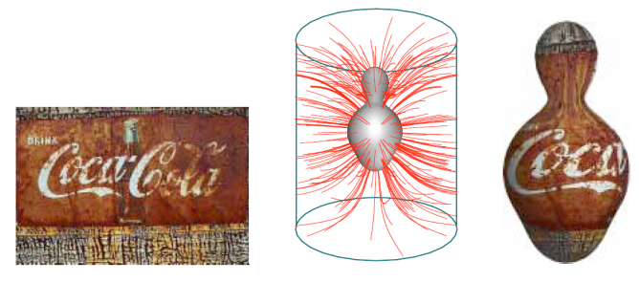

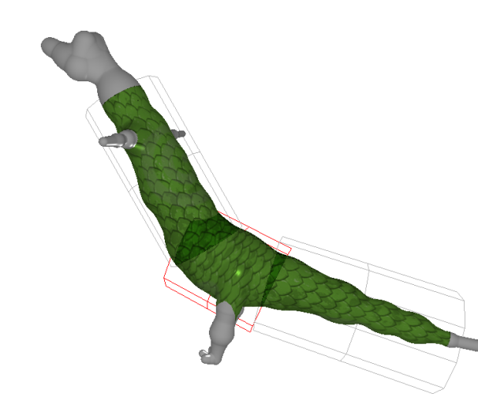
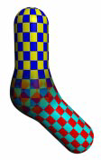
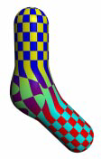
Texturing
Simple projection of 2D textures
Texture mapping with particles
3D Textures

Slide 25
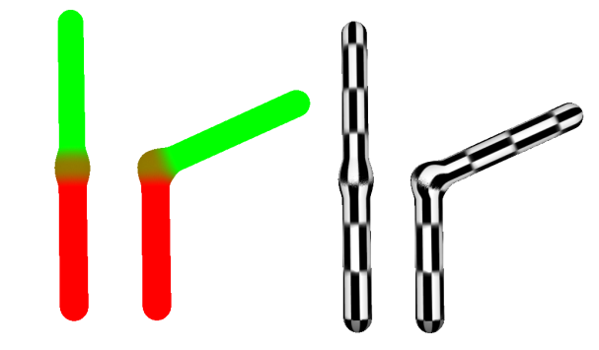
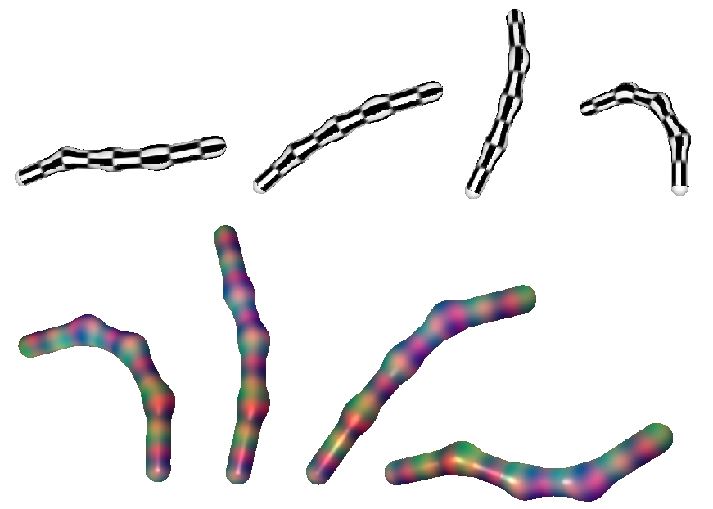
”surface skinning” for a coherent mapping
Analogue technique to mesh skinning
For each pixel
Compute weights wtr. to each bone.
Transform the position of the fragment to the rest position
Look up texture

Slide 26
Adding details, Normal and displacement mapping
Normal of the surface is –DF, The normal displacement can be computed without over cost, no need to compute the tangent frame

Slide 27
Conclusion
We revisited geometric modelling with skeletal implicit surfaces.
We implemented an algorithm to raytrace animated model made of skeletal implicit surfaces.
Using the knowledge about the sources of potential field the surfaces can be ratraced efficiently in a single pass.
Performances stay a lot behind polygon rendering.
The scalability of the algorithm can be improved.
This technique allows interactive texturing but requires extra computation to be compatible with animation.
Normal mapping applies easily but not displacement mapping.

Slide 28
Future Work
Compare other ray-tracing algorithms such as Bézier clipping and sphere tracing.
See how the bisection scheme can apply to other operations on the fields. (BlobTree)
Find a solution for controlling the blending

Slide 29
References
BLINN, J. F. 1982. A Generalization of Algebraic Surface Drawing.
ACM Trans. Graph. 1, 3 (July), 235–256.
BLOOMENTHAL, J. 1995. Skeletal design of natural forms.
PhD thesis, Calgary, Alta., Canada, Canada. UMI Order No.
GAXNN-03088.
FUKUYAMA, T. N., NISHITA, T., AND NAKAMAE, E. 1994. A
method for displaying metaballs by using bezier clipping. Computer
Graphics Forum 13, 271–280.
GOURMEL, O., PAJOT, A., PAULIN, M., BARTHE, L., AND
POULIN, P. 2010. Fitted bvh for fast raytracing of metaballs.
Computer Graphics Forum 29, 2 (may), 281–288.
HART, J. C. 1996. Sphere tracing: a geometric method for the
antialiased ray tracing of implicit surfaces. The Visual Computer
12, 527–545. 10.1007/s003710050084.
KANAMORI, Y., SZEGO, Z., AND NISHITA, T. 2008. GPUbased
fast ray casting for a large number of metaballs. Computer
Graphics Forum (Proc. of Eurographics 2008) 27, 3, 351–360.
LOOP, C., AND BLINN, J. 2006. Real-time gpu rendering of
piecewise algebraic surfaces. In ACM SIGGRAPH 2006 Papers,
ACM, New York, NY, USA, SIGGRAPH ’06, 664–670.
LORENSEN, W. E., AND CLINE, H. E. 1987. Marching cubes: A
high resolution 3d surface construction algorithm. SIGGRAPH
Comput. Graph. 21 (August), 163–169.
REINER, T., MCKL, G., AND DACHSBACHER, C. 2011. Interactive
modeling of implicit surfaces using a direct visualization
approach with signed distance functions. Computers Graphics
35, 3, 596 – 603. Shape Modeling International (SMI) Conference
2011.
SCHMIDT, R., WYVILL, B., SOUSA, M. C., AND JORGE, J. A.,
2005. Shapeshop: Sketch-based solid modeling with blobtrees.
SHERSTYUK, A. 1999. Convolution Surfaces in Computer Graphics.
PhD thesis, Monash, Monash, Australia, Australia.
STICH, M., FRIEDRICH, H., AND DIETRICH, A. 2009. Spatial
splits in bounding volume hierarchies. In Proc. High-
Performance Graphics 2009.
SUGIHARA, M., WYVILL, B., AND SCHMIDT, R. 2010.
WarpCurves: A tool for explicit manipulation of implicit surfaces.
Computers & Graphics 34, 3, 282–291. Shape Modeling
International (SMI) 2010.
TIGGES, M., AND WYVILL, B. 1998. Texture mapping the blobtree.
In In Proceedings of the Third International Workshop on
Implicit Surfaces, 123–130.
WYVILL, B., GALIN, E., AND GUY, A. 1998. The Blob Tree,
Warping, Blending and Boolean Operations in an Implicit Surface
Modeling System. Implicit Surfaces 3 (June). Chosen for
inclusion in a special issue of Computer Graphics Forum.

